Slide 1
2023 Certification
AETNA Individual Medicare
Broker Services Department

Slide 2
Our vision
To add flexibility by offering a new “free of charge” option to complete 2023 Aetna Individual Medicare certification along with our existing process.
Notes:
For the upcoming Certification season our vision was to add flexibility by offer a new free of charge option to complete the 2023 Individual Medicare Certification along with our existing process.

Slide 3
CHOOSE your path
New!
Choice 1
AHIP Medicare Training
Cost $125 (This charge is consistent with prior years)
Free to Frontrunners
Available from Aetna website
Complete AHIP or
transmit AHIP completed
through another carrier
to unlock the Aetna learning plan
Note: Frontrunners must take AHIP through the Aetna site on or after June 29 in order to receive free AHIP training.
Choice 2
Aetna Homegrown Medicare Compliance Training
To market Aetna-only
Free of charge
Available from Aetna website
Complete as a
replacement for AHIP
to unlock the Aetna learning plan

Slide 4
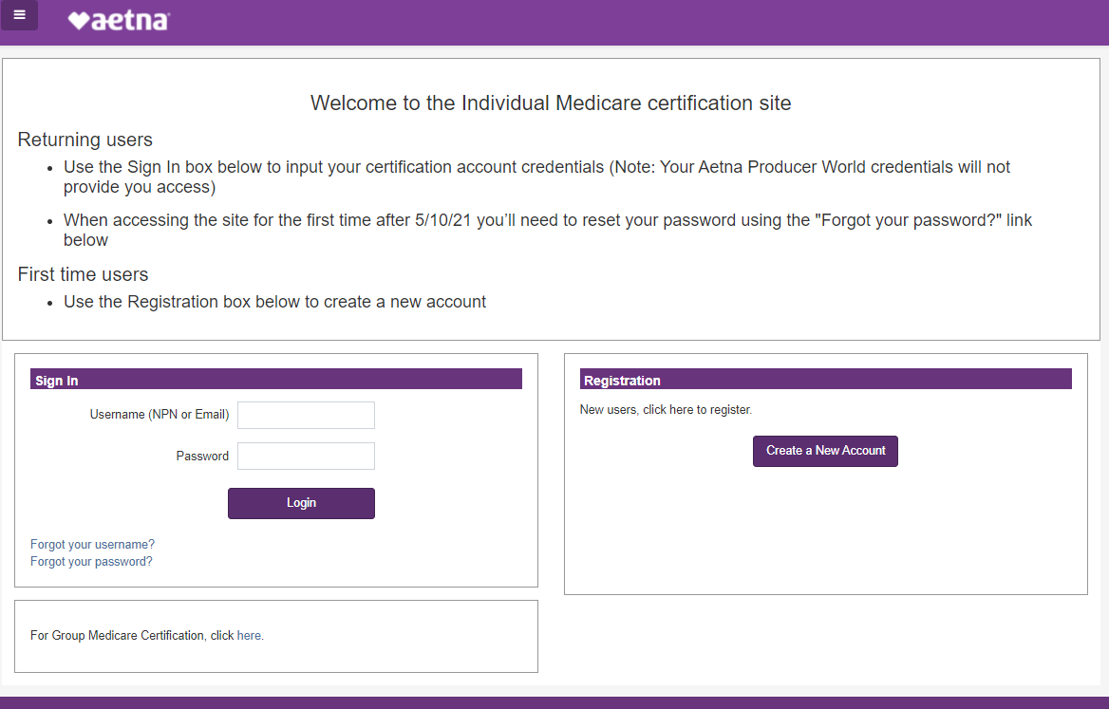
START at the Aetna certification website
Aetna Certification Website
www.AetnaMedicareProducerCertification.com

Slide 5
FINISH your training
Cost $125
Free to Front Runners
Cost $0
Free to sell Aetna only!
AHIP Medicare Training
AHIP Medicare Training
Medicare General Compliance
Fraud, Waste and Abuse
Aetna Core Training and Exam
Aetna Attestations:
FDR, MST & 3rd Party Website
SilverScript Prescription Drug Plan Training and Exam
Aetna MA/MAPD Overview Training
Aetna D-SNP Training
MA/MAPD/DSNP Exam
Aetna Homegrown Medicare Compliance Training
Aetna Homegrown Medicare Training
Aetna Core Training and Exam
Aetna Attestations:
FDR, MST & 3rd Party Website
SilverScript Prescription Drug Plan Training and Exam
Aetna MA/MAPD Overview Training
Aetna D-SNP Training
MA/MAPD/DSNP Exam

Slide 6
Important 2023 Notables
2023 AHIP training goes live June 20th, 2022, Broker’s marketing Aetna Individual Medicare products are encouraged to wait until Aetna Certification goes live to certify.
Aetna’s Individual Medicare Certification planned “Go Live” is scheduled for Wednesday June 29th, 2022.
Aetna Homegrown Medicare Compliance Training will only allow brokers to market Aetna plans.
Aetna Homegrown Medicare Compliance Training not transferrable to other carriers.
Aetna Homegrown Medicare Compliance Training will not qualify for CE credits.
“Dual-Year” certification will be available for 2022-2023 crossover selling through November.

